Slide 1


Slide 4
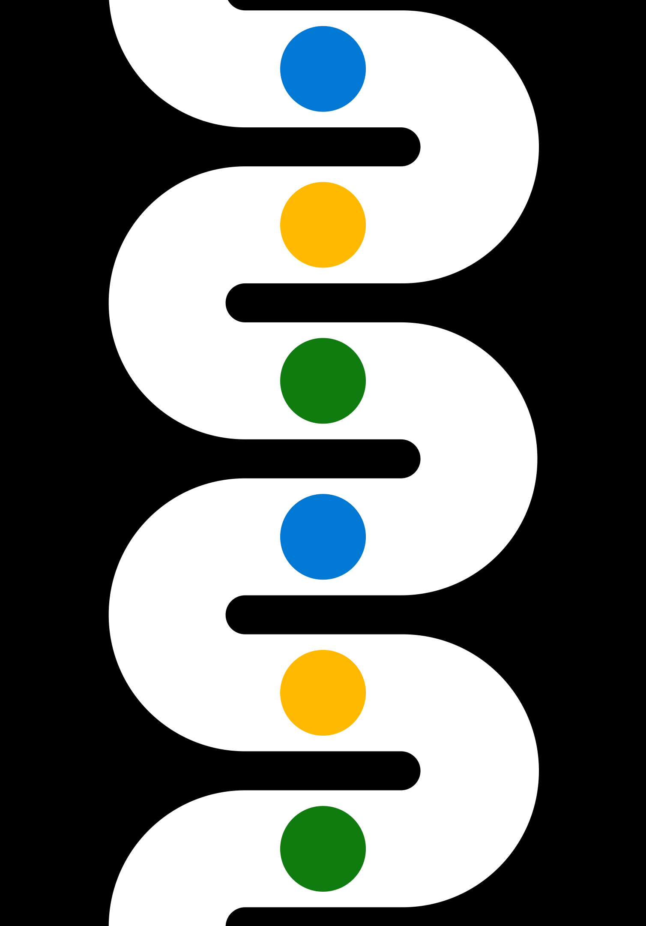

Slide 5


Slide 6



Slide 7

Contoso play
Contoso play
Contoso play

